Slide 1
Title: Nature’s Pharmacy: Unveiling the Therapeutic Potentials of Medicinal Plants
Name: Masud Miah
ID: 01-024-15

Slide 2
Data Table (Link):
project work-DESKTOP-GSIRSM5.xlsx

Slide 3
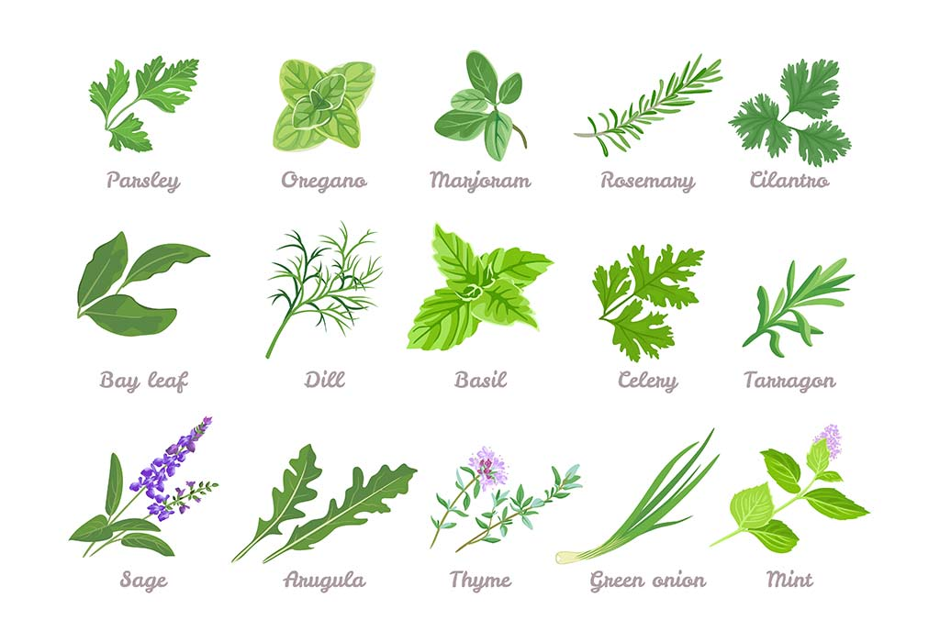
Introduction
Medicinal plants have been used for thousands of years across various traditional systems, including Ayurveda, Traditional Chinese Medicine, and Indigenous practices. Today, they are regaining attention for their potential to treat modern health conditions.

Slide 4
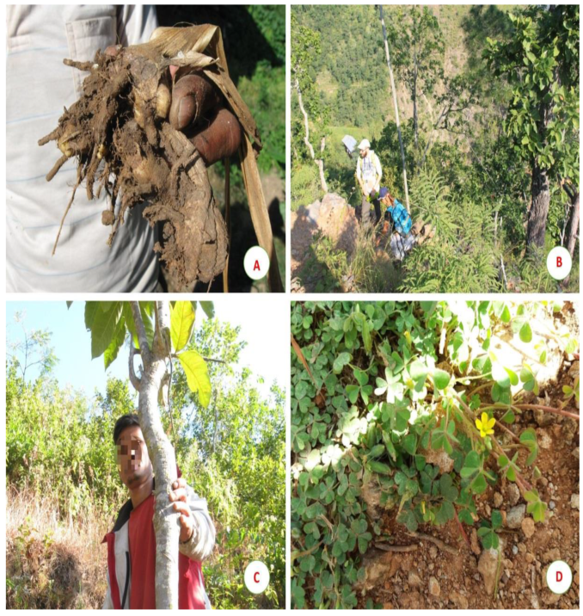
Medicinal Plants in Traditional Medicine
Used for thousands of years across various cultures
Examples: Ayurvedic, Traditional Chinese Medicine (TCM), Indigenous healing systems

Slide 5
Medicinal plants contain bioactive compounds such as:
Alkaloids
Flavonoids
Terpenoids
Polyphenols
These compounds possess anti-inflammatory, antimicrobial, antioxidant, and anticancer properties, making them valuable for both natural remedies and modern drug development.

Slide 6
1. What are the most commonly used medicinal plants across different cultures and traditions?

Slide 7
2. What are the bioactive compounds found in medicinal
Plant and how do they contribute to their therapeutic
effects?
Aloe Vera
Aloin, Anthraquinones
Anti-inflammatory, wound healing
Ashwagandha
Withanolides, Alkaloids
Adaptogenic, anxiolytic
Catnip
Nepetalactone, Tannins
Sedative, digestive aid

Slide 8
Chamomile
Apigenin, Bisabolol
Sedative, anti-inflammatory
Dandelion
Taraxasterol, Inulin
Detoxification, diuretic
Echinacea
Chicoric acid, Alkamides
Immunomodulatory, anti-inflammatory

Slide 9
Elderberry
Anthocyanins, Flavonoids
Antiviral, immunomodulatory
Garlic
Allicin, Sulfur compounds
Cardioprotective, antimicrobial
Ginger
Gingerol, Shogaol
Digestive aid, anti-nausea

Slide 10
Ginseng
Ginsenosides, Polysaccharides
Immunomodulatory, adaptogenic
Lavender
Linalool, Linalyl acetate
Anxiolytic, sedative
Licorice
Glycyrrhizin, Flavonoids
Anti-inflammatory, hepatoprote

Slide 11
Thyme
Thymol, Carvacrol
Antimicrobial, carminative
Tulsi
Eugenol, Ursolic acid
Adaptogenic, antimicrobial
Turmeric
Curcumin, Demethoxycurcumin
Anti-inflammatory, antioxidant

Slide 12
3.Which parts of medicinal plant are mostly used for medicinal uses?

Slide 13
Key Observations:
Berries:
Aloe Vera is represented by a blue bar.
Elderberry also shows a count for berries (light blue).
Bulb:
Garlic(dark red) is the only plant represented, as bulbs are commonly used.
Flowers:
Plants like Chamomile (purple), Lavender (light blue), and Peppermint (light green) show counts, indicating that their flowers are used for medicinal purposes.

Slide 14
Leaves:
A wide range of plants use leaves, including Ashwagandha (red), Dandelion (teal), Echinacea (light orange), Neem (brown), and Peppermint.
Rhizome:
Ginger (green) and Turmeric are represented, as their rhizomes (underground stems) are commonly used.
Roots:
Licorice (orange) and Ginseng (light purple) are primarily used for their roots.
Seeds:
Milk Thistle (light purple) is highlighted here for its use of seeds.

Slide 15
Conclusion
The synergy between modern science and traditional knowledge is unlocking new possibilities, making medicinal plants a promising source for future pharmaceuticals and natural health products.

